Slide 1
Investigational Drugs in VA:
Expanded Access Use, Emergency Use Authorizations, and
Use under the Right to Try Law
Dial in (Main): (631) 992-3221
Dial in (Alt): (516) 453-0031
Attendee Access Code: 535-214-687
Slides in “Handout” Tab
C. Karen Jeans, PhD, CCRN, CIP
Director, Regulatory Affairs, ORPP&E
VHA Office of Research & Development
August 27, 2020

Slide 2
Objectives
Define the major regulatory and legal differences for VHA’s use of investigational drugs and biologics prescribed and administered under the:
  U.S. Food and Drug Administration’s (FDA) expanded access regulations
  FDA’s emergency use authorization
  Right to Try Act (Public Law 115-176)
Describe key policies and VA responsibilities related to the publication of VHA Notice 20-23(1): Right to Try
Apply the regulatory and legal differences between an expanded access use (Mayo Clinic Expanded Access Program) vs. an emergency use authorization for COVID-19 convalescent plasma (CCP)

Slide 3
Pathways for Use of Drugs and Biologics
U.S. Drugs and Biologics
Approved Drugs and Biologics
Investigational Drugs and Biologics
(Non-Approved)
Use According to FDA Marketed Label
Off Label Use of Approved Drug
Commercial and
Non-Commercial Investigational New Drug Applications (INDs)
Expanded Access
INDs
Emergency Use Authorization
Right to Try Act

Slide 4
Pathways for Use of Investigational Drugs and Biologics
Investigational Drugs and Biologics
(Non-Approved)
Commercial and
Non-Commercial Investigational New Drug Applications (INDs)
Expanded Access
INDs
Emergency Use Authorization
Right to Try
Act

Slide 5
Pathways for Use of Investigational Drugs and Biologics
VHA allows each of these pathways to be used as per the requirements of each.
However, all VHA Medical Facilities are not permitted to use each pathway.
The remainder of this presentation will focus on the following three pathways for investigational drugs and biologics used under:
  FDA’s Expanded Access Regulations
  FDA’s Emergency Use Authorization, or the
  Right to Try Act

Slide 6
Poll 1: Determining when the Drug’s Use is Investigational
Question: In which of the following pathway(s) is the use of the drug considered to be an “investigational drug”?
a. FDA’s expanded access regulations
b. FDA’s emergency use authorization
c. The Right to Try Law
d. A and B
e. All of the above

Slide 7
Poll #1 Question and Answer: In which of the following pathway(s) is the use of the drug considered to be an “investigational drug”?
Answer: E.
Regardless of the three pathways, the use of these unapproved drugs or biologic without an approved marketing application is an investigational drug.
FDA often uses the words “experimental drug” to refer to an investigational drug.
Reference: https://www.fda.gov/patients/learn-about-expanded-access-and-other-treatment-options/understanding-investigational-drugs

Slide 8
Poll 2: Determining when the Investigational Drug’s Use Requires IRB Approval or Notification
Question: In which of the following pathway(s) is the use of the drug required to have IRB approval or notification?
a. FDA’s expanded access regulations
b. FDA’s emergency use authorization
c. The Right to Try Law
d. A and B
e. All of the above

Slide 9
Poll #2 Question and Answer: In Which of the Following Pathway(s) is the Use of the Drug Required to Have IRB Approval or Notification?
Answer: A. (Expanded Access Regulations)
While an investigational drug is used in all three pathways, FDA’s regulations only require IRB approval or IRB notification for any investigational drug or biologic given under FDA’s expanded access regulations.
References: 21 CFR 312.305(c)(4) and § 56.104(c)

Slide 10

Differentiating Between the Three Pathways Can Be Confusing
Do I Pick a Color and Hope that It is the Right One?
Right to Try
Act
No IRB Approval or Notification
No FDA Oversight
Expanded Access
INDs
IRB Approval or Notification
FDA Regulations Apply
Emergency Use Authorization
No IRB Approval or Notification
FDA Regulations Apply

Slide 11

When Investigational Drugs or Biologics Are Used Under FDA’s Expanded Access Regulations
Sometimes called “compassionate use”, expanded access is a potential pathway for a patient to gain access to an investigational drug or biologic for treatment outside of clinical trials
Reference: https://www.fda.gov/news-events/expanded-access/expanded-access-information-physicians

Slide 12
When Investigational Drugs or Biologics Can be Given Under FDA’s Expanded Access Regulations
Used when the following are met:
  when no comparable or satisfactory alternative therapy options are available
  with an immediately life-threatening condition or serious disease or condition
  Patient enrollment in a clinical trial is not possible.
  Potential patient benefit justifies the potential risks of treatment.
  Providing the investigational medical product will not interfere with investigational trials that could support a medical product’s development or marketing approval for the treatment indication.

Slide 13
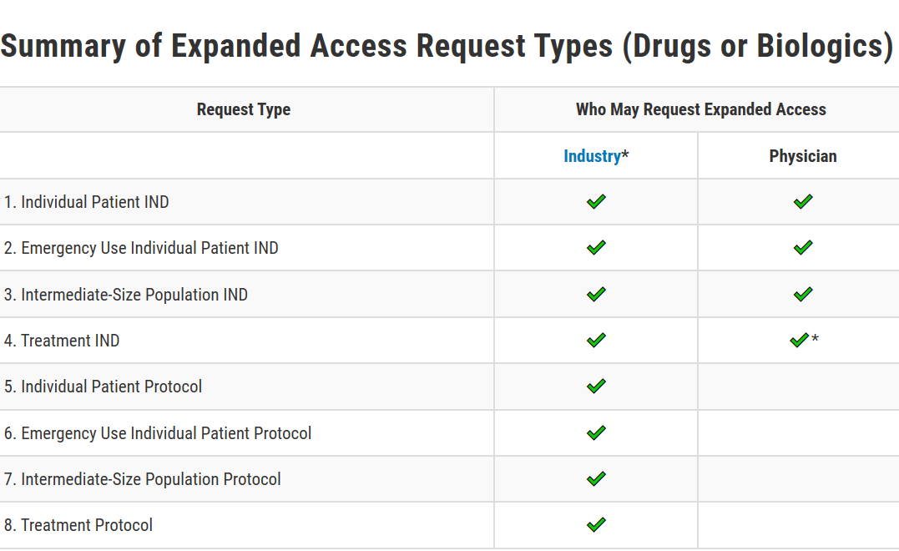
Summary of Different Types of Expanded Access: Drugs and Biologics
Source: https://www.fda.gov/news-events/expanded-access/expanded-access-how-submit-request-forms

Slide 14
What Research Committees or Subcommittees are Required to Review or Approve When a VA Physician Wants to Request an Investigational Drug or Biologic Through Expanded Access?
Emergency Expanded Access IND
No Prospective IRB Approval
IRB Notification Required 5 Working Days After Beginning Administration
No VA Research and Development Committee approval or Notification required by ORD policy
Non-Emergency Expanded Access IND
Prospective IRB Approval Required
Prospective VA Research and Development Committee approval Required
*Designated Review can be used by the R&D Committee for any non-emergency expanded use

Slide 15
Do All Non-Emergency Expanded Access Uses Require IRB Approval by a Convened IRB?
All non-emergency expanded access uses require review and approval by a convened IRB EXCEPT

Slide 16
Requirements for Approval of Alternative IRB Review for Investigator-Held Single-Patient
Non-Emergency INDs
  For an investigator-held single patient non-emergency IND for expanded access, an alternative IRB review for concurrence by the IRB chairperson or by a designated IRB member can be used ONLY if the following are met:
    The FDA approves the use of the alternative IRB review upon submission of FDA Form 3926 with the investigator’s request to use an alternative IRB review procedure
    AND
    The sponsor providing the investigational drug for the investigator’s submission of the single patient IND allows for the alternative IRB review process.
    Please check with the sponsor allowing the investigational use for submission of the IND prior to submitting the FDA Form 3926.

Slide 17
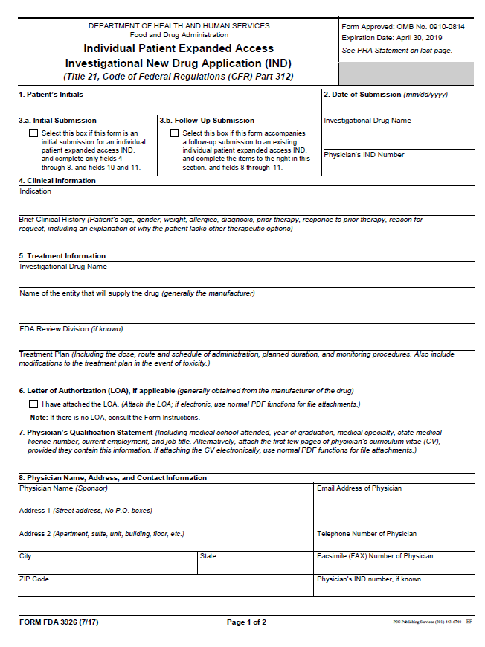
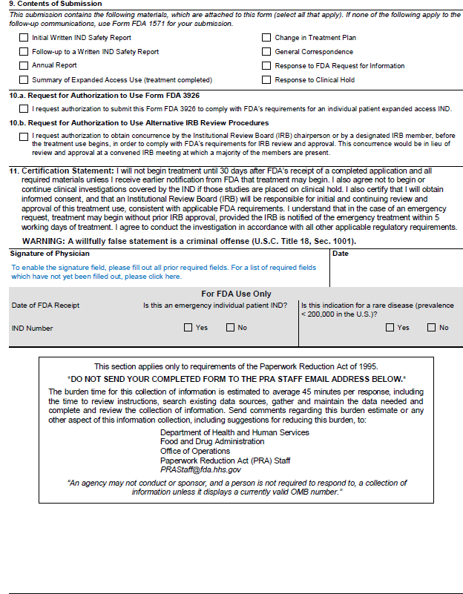
FDA Form 3926: Individual Patient Expanded Access Investigational New Drug Application (IND)

Slide 18
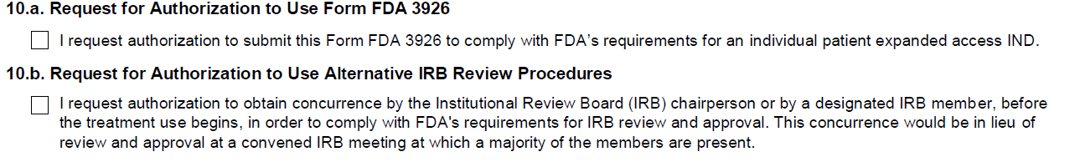
FDA Form 3926: Individual Patient Expanded Access Investigational New Drug Application (IND)
Box 10.b.: Request for Authorization to Use Alternative IRB Review Procedures

Slide 19

Right To Try Act

Slide 20
What is the Right to Try Act?
The Right to Try Act, or the Trickett Wendler, Frank Mongiello, Jordan McLinn, and Matthew Bellina Right to Try Act, was signed into law May 30, 2018.
Another way for patients who have been diagnosed with life-threatening diseases or conditions who have tried all approved treatment options and who are unable to participate in a clinical trial to access certain unapproved treatments.

Slide 21
Access to Investigational Drugs:
Right to Try Act
The Right to Try Act permits/allows eligible patients to have access to eligible investigational drugs.
An eligible patient is a patient who has:
  Been diagnosed with a life-threatening disease or condition
  Exhausted approved treatment options and is unable to participate in a clinical trial involving the eligible investigational drug
  And has provided, or their legally authorized representative has provided, written informed consent regarding the eligible investigational drug to the treating physician

Slide 22
Access to Investigational Drugs:
Expanded Access vs. Right to Try Law
Expanded Access
Use of Investigational Drug
Requires IRB prospective approval or IRB notification if emergency use
Use regulated by FDA as per 21 CFR Part 312.300
Sponsor decides whether to make the investigational drug available for expanded access
Right to Try Act
Use of Investigational Drug
No IRB approval or notification
FDA does not review or approve requests for Right to Try Act use. FDA’s role is limited to receipt and posting of certain information submitted under the Right to Try Act.
Sponsor decides whether to make the investigational drug available for use under the Right to Try Law

Slide 23
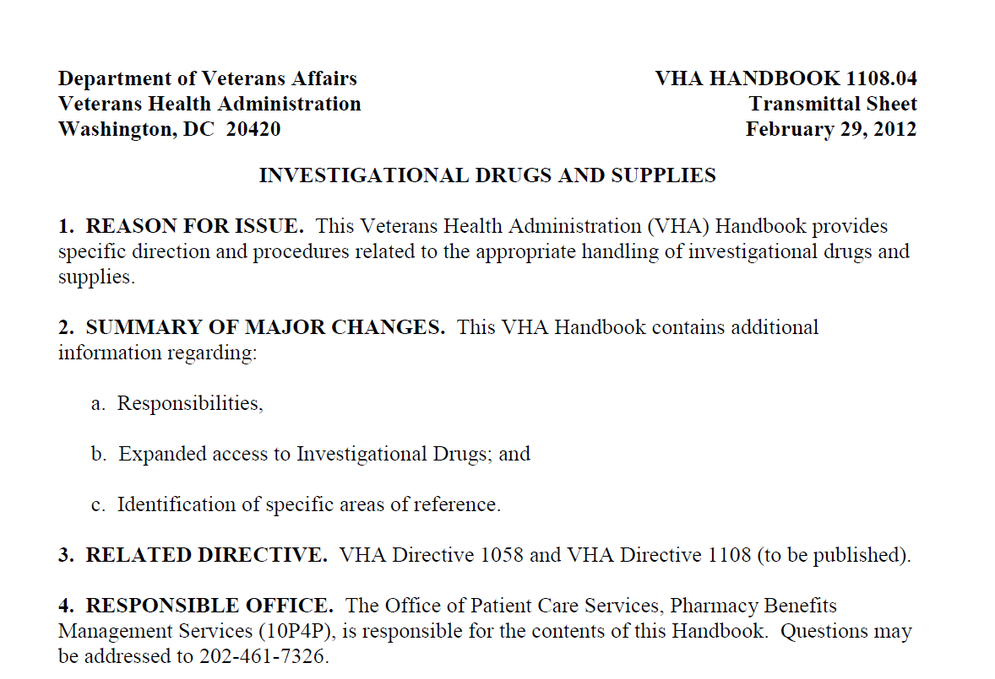
VHA Handbook 1108.04: Investigational Drug and Supplies (February 29, 2012)

Slide 24
VHA Handbook 1108.04 Policies
Provides specific direction and procedures related to the appropriate handling of investigational drugs and supplies;
Describes roles and responsibilities of:
  VA Facility Director
  Research Service
  Sponsors
  Investigator
  VA Facility Chief of Pharmacy Service

Slide 25
VHA Handbook 1108.04 Policies For Expanded Access Use of Investigational Drugs
Paragraph 13 contains the policies addressing “Expanded Access to Investigational Drugs”.
Reinforces the requirements to follow FDA’s regulations.
Does not contain policies for investigational drugs administered under the Right to Try Act.

Slide 26
VHA Notice 20-23(1): Right to Try
Issued on July 22, 2020 and amended on July 31, 2020.
Interim policy issued to provide policies and procedures while VA’s regulations and a new VHA Directive specific to Right to Try are being prepared.
VHA Handbook 1108.04 is also in the process of being revised.

Slide 27
VHA Notice 20-23(1): Right to Try:
Key Unique Definitions Specific to the Notice and the Act: Paragraph 2.a.: Eligible Investigational Drug
Eligible Investigational Drug. An eligible investigational drug has:
  completed Food and Drug Administration (FDA) approved Phase 1 clinical trial,
  has not been approved or licensed for use by the FDA, is in an active clinical trial under an application for approval or subject for an application for approval that has been filed with the FDA and
  is under ongoing active development or production that has not been discontinued by the manufacturer or placed on a clinical hold.
  NOTE: This definition may only be used for purposes of this directive.

Slide 28
VHA Notice 20-23(1): Right to Try:
Key Unique Definitions
Paragraph 2.b.: Eligible Patient
Eligible Patient. An eligible patient is a patient
  that is diagnosed with a life-threatening disease or condition,
  has exhausted approved treatment options,
  is unable to participate in a clinical trial involving the eligible investigational drug as certified by a physician and
  provides written informed consent regarding the risks associated with taking the eligible investigational drug.

Slide 29
VHA Notice 20-23(1): Right to Try:
Key Unique Definitions: Paragraph 2.c. Life-Threatening Disease or Condition
Life-Threatening Disease or Condition. A life-threatening disease or condition is a disease or condition where the
  likelihood of death is high unless the course of the disease is interrupted and
  a disease or condition with potentially fatal outcomes, where the end point of clinical trial analysis is survival.

Slide 30

VHA Notice 20-23(1): Right to Try:
Required Steps
Agreement
Local COS Approval
Information to
Pharmacy
Written Consent
Ethics Consult if Needed
Pharmacy Notified when Administered

Slide 31
VHA Notice 20-23(1): Right to Try:
Required Step #1: Written Agreement
Written Agreement
  Before administration of an eligible investigational drug to a patient, the VA medical facility Director will execute a written agreement between the VA medical facility and a sponsor supplying an eligible drug.
  The VA medical facility Pharmacy Services will maintain the agreement as part of the VA medical facility’s records.
  Please note that these are not “standardized agreements”. The sponsor will supply the agreement.
  These agreements will be reviewed by your VA legal counsel.
  Reference: Paragraph 3.a.

Slide 32
VHA Notice 20-23(1): Right to Try:
Required Step #2:
VA Facility Chief of Staff Approval
2. VA Medical Facility Chief of Staff Approval:
  The VA medical facility Chief of Staff must approve any health care provider before they can order an eligible investigational drug.
Reference: Paragraph 3.b.

Slide 33
VHA Notice 20-23(1): Right to Try:
Required Step #3:
Required Information to the Pharmacy Service
3. Prescribing Health Care Provider’s Responsibility to Provide Information to the VA Facility Pharmacy Service:
  The prescribing health care provider must provide the VA medical facility Pharmacy Service information about the eligible investigational drug, including
    allergies,
    toxicities or
    adverse drug reactions related to the investigational drug or the potential for interaction with other drugs, foods or dietary supplements, including a prescription for the eligible investigational drug.
    NOTE: The prescribing physician must be in good standing with their licensing organization or board and will not be compensated directly by the manufacturer.
  Reference: Paragraph 3.c.

Slide 34
VHA Notice 20-23(1): Right to Try:
Required Step #4: Consent
4. Written consent must be obtained from the patient or the patient’s legally authorized representative prior to the VA Facility Pharmacy Service dispensing the eligible investigational drug.
The consent must be maintained as part of the VA Medical Facility Pharmacy Service’s Records.
The patient or the patient’s legally authorized representative must sign and date the consent form.
This consent is not an IRB-approved consent form; the IRB does not have authority to “approve” the informed consent form.
The consent form template will be supplied by the sponsor; it must be reviewed by your VA Facility.
Reference: Paragraph 3.d.

Slide 35
VHA Notice 20-23(1): Right to Try:
Required Step #4: Consent (cont.)
Required elements of the consent form must include:
Name of the drug,
A statement that the drug is investigational but that this activity is not research as the drug is being administered under the Right to Try Act,
An explanation of the purposes of the drug and a description of the procedures to be followed,
A description of any reasonably foreseeable risks or discomforts to the patient,

Slide 36
VHA Notice 20-23(1): Right to Try:
Required Step #4: Consent (cont.)
A description of any benefits to the patient that may reasonably be expected from the drug,
A disclosure of appropriate alternative procedures or courses of treatment, if any, that might benefit the patient,
A statement of any costs that would be incurred by the patient for treatment with the drug and
An explanation of whom to contact for answers to pertinent questions about the drug.

Slide 37
VHA Notice 20-23(1): Right to Try:
Required Step #5:
Local VA Facility Ethics Consultation If Needed
5. Prior to the administration of the investigational drug, a local VA medical facility ethics consultation is required if there is a values-based uncertainty or conflict about prescribing or administering the eligible investigational drug.
Example Scenario: A physician’s patient requests access to an eligible investigational drug under the Right to Try Act. The patient’s physician does not think the treatment should be administered, but another healthcare provider disagrees.
Reference: Paragraph 3.d.

Slide 38
VHA Notice 20-23(1): Right to Try:
Required Step #6:
VA Facility Pharmacy Service Notification of Administration
  The VA medical facility Pharmacy Services must be notified in writing upon administration of an eligible investigational drug by the prescribing health care provider.
    The VA medical facility Pharmacy Service will notify Pharmacy Benefits Management.
    Reference: Paragraph 3.f.

Slide 39
VHA Notice 20-23(1): Right to Try:
Costs and Reporting by Manufacturer to FDA
  VA co-payment patient costs: None.
  VA Medical Facility costs: If the sponsor is requiring the VA Medical Facility to purchase the eligible investigational drug, the VA Medical Facility Pharmacy Service must be consulted for approval on reimbursement and payments.
  FDA reporting: The Right to Try Law requires reporting by the manufacturer of the use of eligible investigational drugs to FDA.

Slide 40

Eligible Investigational Drugs Administered Under the Right to Try Act:
Important Issues to Remember
It is rare to use eligible investigational drugs under the Right to Try Act.
There are only 2 publicly known cases of Right to Try as of July 29, 2020 since the Law was signed in 2018.

Slide 41

Eligible Investigational Drugs Administered Under the Right to Try Act:
Important Issues to Remember
Most Sponsors and/or Manufacturers will not make their investigational drugs available under the Right to Try Act, nor are they required to do so under the Act.

Slide 42

Eligible Investigational Drugs Administered Under the Right to Try Act:
Important Issues to Remember
A sponsor cannot make the investigational drug available under the expanded access regulations AND the Right to Try Act at the same time.

Slide 43
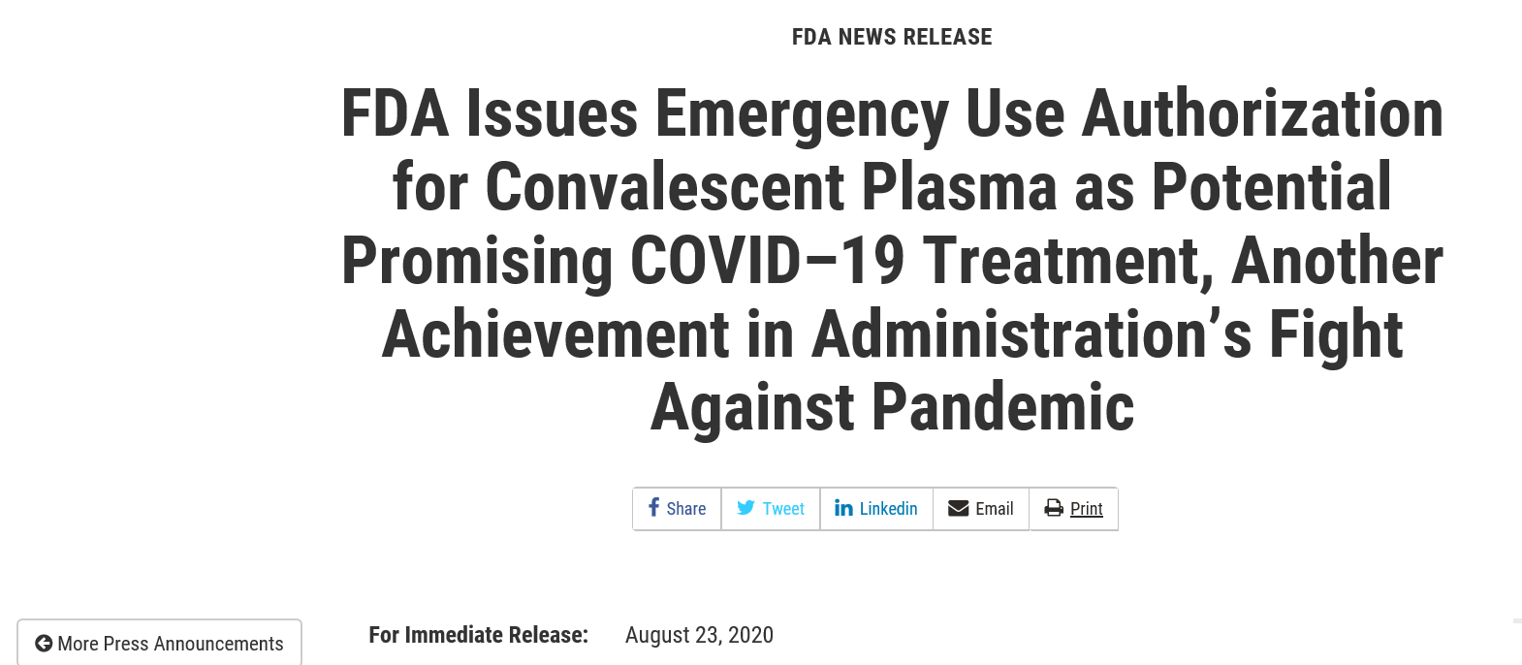
Emergency Use Authorizations
Reference: https://www.fda.gov/news-events/press-announcements/fda-issues-emergency-use-authorization-convalescent-plasma-potential-promising-covid-19-treatment

Slide 44
Emergency Use Authorizations (EUAs)
The Emergency Use Authorization (EUA) authority under the Food, Drug, and Cosmetic Act allows FDA to help strengthen the nation’s public health protections against chemical, biological, radiological, or nuclear (CBRN) threats by facilitating the availability and use of medical countermeasures needed during public health emergencies.
Medical countermeasures (MCMs) are life-saving medicines and medical supplies regulated by the U.S. Food and Drug Administration (FDA) that can be used to
  diagnose,
  prevent,
  protect from, or
  treat conditions associated with chemical, biological, radiological, or nuclear (CBRN) threats, emerging infectious diseases, or a natural disaster.

Slide 45
Emergency Use Authorizations
The FDA decides whether the use of the product is likely to be more helpful than harmful for the emergency situation.
Use of an investigational drug or biologic under a MCM does not mean that the FDA has granted approval or licensure for the drug.
Use of an investigational drug or biologic under an EUA is not research.
If the investigational drug or biologic is being evaluated as part of a clinical trial, an IND is required.

Slide 46
Emergency Use Authorizations
No separate EUA-specific informed consent is required to be signed by the patient (not a human subject).
Product-specific information pertaining to the emergency use under the authorization must be provided to healthcare providers and patients and parents/caregivers

Slide 47
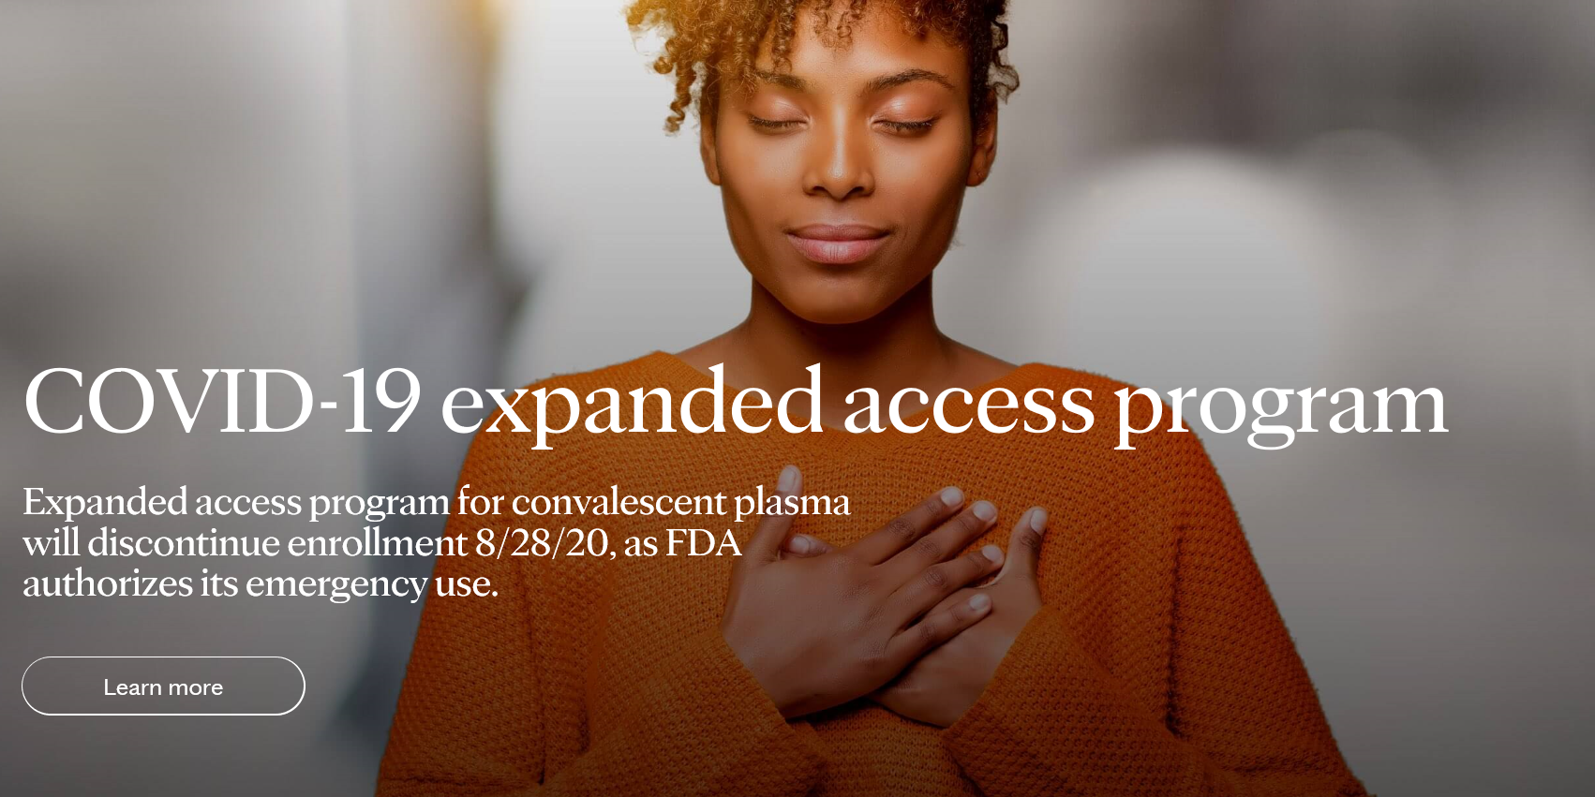
The Mayo Clinic Expanded Access Program for COVID-19 Convalescent Plasma (CCP): Closing the Expanded Access Program and Accessing CCP Through the EUA
https://www.uscovidplasma.org

Slide 48
Discontinuation of the Mayo Clinic Expanded Access Program (EAP)
August 28th: All physician registration and patient/subject enrollment ends.
Do not stop providing required patient data from enrolled subjects in the EAP if data collection is not completed on August 28th.
VA Investigators should contact the Mayo Clinic if there are questions regarding data collection on enrolled subjects who have not completed the end of study at uscovidplasma@mayo.edu.
The Mayo Clinic EAP iMedConsent™ will be removed after August 28th. No action is required to be taken by local VA Facilities to remove the consent form.

Slide 49
When Can a VA Investigator in a Participating VA Facility Close the Mayo Clinic EAP?
Never Enrolled Patients/Subjects
Enrolled Subjects but Data Collection Not Complete
Enrolled Subjects but Data Collection Completed on all Subjects
Complete Data Collection on Enrolled Subjects
Inform the R&D Committee the Mayo Clinic EAP Can be Closed

Slide 50
Is a VA Investigator Required to Inform the Mayo Clinic IRB When the Participating Site Closes?
No.
Once all follow up data on all patients have been provided and the weekly status update/end of study form for all patients have been completed, the study is ready to be closed.
The Mayo Clinic IRB is not requiring a letter from the VA Investigator to close the study, nor will there be communication from the Mayo Clinic IRB or Study Sponsor to close the study.

Slide 51
Closing the Mayo Clinic EAP
There is no need nor requirement to inform ORO or ORD that your participating VA Facility has closed the study.
There are no revisions to your VA Facility’s Federal Wide Assurance to remove the Mayo Clinic IRB as an IRB of Record because it was not required for this specific study.
The end of the Mayo Clinic EAP ends your VA Facility’s IRB reliance with the Mayo Clinic IRB.
If your VA Facility wished to rely upon the Mayo Clinic IRB for another study in the future, ORD policies must be followed for reliance on the Mayo Clinic IRB as per ORD policy. Please see instructions at https://www.research.va.gov/programs/orppe/single_irb.cfm

Slide 52
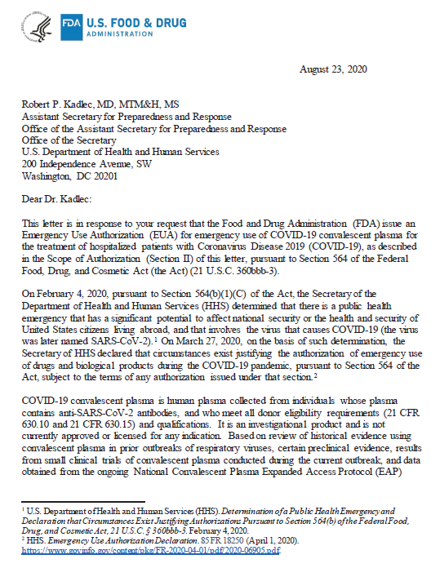
Use of COVID-19 Convalescent Plasma: Emergency Use Authorization
https://www.fda.gov/media/141477/download

Slide 53
Use of COVID-19 Convalescent Plasma: Emergency Use Authorization
Use of CCP under the EUA is not research.
  Clinicians who prescribe CCP under the EUA are not Investigators.
The process your VA Facility uses to obtain CCP does not change as a result of the closure of the Mayo Clinic EAP.
Your VA Facility cannot choose to continue IRB review and oversight for use of CCP under the EUA.
However, if CCP is used in a clinical trial, CCP requires approval of an IND from FDA and IRB and R&D Committee approval.

Slide 54

Do Not Misinterpret CCP’s Emergency Use Authorization

Slide 55

CCP is Not Standard of Care for COVID-19
EUA for COVID-19 Convalescent Plasma
Standard of Care or Usual Care for Treatment of COVID-19
Information from well-controlled randomized clinical trials (RCTs) are needed.

Slide 56
CCP Emergency Use Authorization:
Scope of the EUA
EUA is active as of August 23, 2020.
  The authorization will continue only for the duration of the declaration that circumstances exist justifying the authorization of the emergency use of drugs and biological products during the COVID-19 pandemic unless the authorization is terminated or revoked sooner.
EUA for CCP allows for its use in all hospitalized patients with Covid-19.
Use of CCP by VA Investigator for a non-hospitalized individual is outside the scope of the EUA.
  Requires approval of an IND from FDA, IRB approval, and R&D Approval.

Slide 57
CCP Emergency Use Authorization:
EUA Requirements
Plasma donations must be tested by registered or licensed blood establishments for anti-SARS-CoV-2 antibodies as a manufacturing step to determine suitability before release.
Units tested by the Ortho VITROS SARS-CoV-2 IgG test and found to have a signal-to-cutoff (S/C) value of 12 or greater qualify as high titer COVID-19 convalescent plasma.
Units containing anti-SARS-CoV-2 antibodies but not qualified as high titer by the test described above are considered low titer units and must be labeled accordingly.
The health care provider may assess whether units with a S/C value of less than 12 are acceptable for use based on an individualized assessment of benefit-risk.

Slide 58
CCP Emergency Use Authorization:
EUA Requirements
Health care providers will administer the authorized COVID-19 convalescent plasma with anti-SARS-CoV-2 antibodies according to standard hospital procedures and institutional medical and nursing practices.
Clinical dosing may first consider starting with one COVID-19 convalescent plasma unit (about 200 mL), with administration of additional COVID-19 convalescent plasma units based on the prescribing physician’s medical judgment and the patient’s clinical response.

Slide 59
CCP Emergency Use Authorization:
EUA Requirements
COVID-19 convalescent plasma is authorized to be accompanied by the following product specific information required to be made available to health care providers and patients respectively:
  Fact Sheet for Health Care Providers: Emergency Use Authorization (EUA) of COVID-19 Convalescent Plasma for Treatment of COVID-19 in Hospitalized Patients, and
  Fact Sheet for Patients and Parents/Caregivers: Emergency Use Authorization (EUA) of COVID-19 Convalescent Plasma for Treatment of COVID-19 in Hospitalized Patients.
    This fact sheet will be uploaded into iMedConsent™ as educational material.

Slide 60
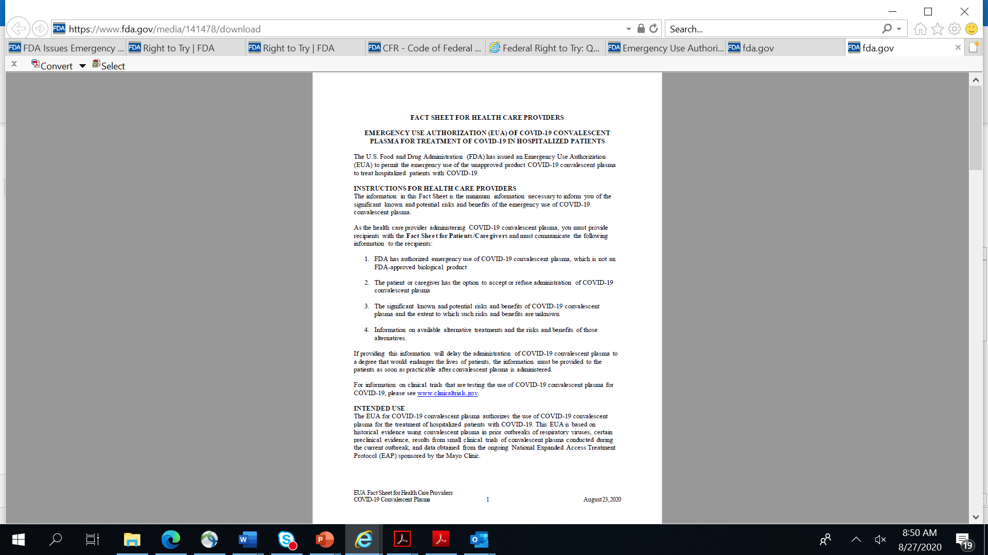
CCP Emergency Use Authorization:
Health Care Provider Requirements: Fact Sheet
Contains information that the Health Care Provider must follow:
  Information to be conveyed to patients or caregivers
  Dosing instructions
  FDA has authorized emergency use of COVID-19 convalescent plasma, which is not an FDA-approved biological product
  Side effects
  Reporting for blood transfusion reactions or deaths

Slide 61
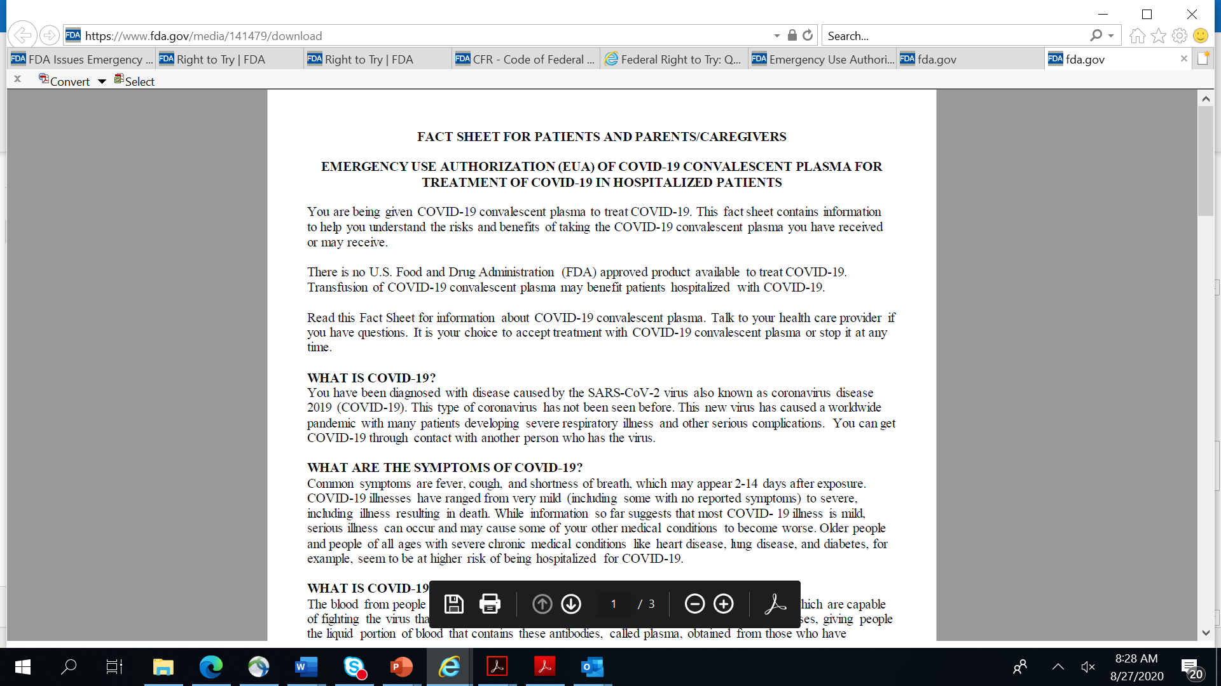
CCP Emergency Use Authorization:
EUA Requirements: Patient Consent
The Fact Sheet for Patients and Parents/Caregivers is not a consent document.
The Fact Sheet must be provided to the patients or caregivers, but it is not to be signed.
  Do not put a signature line and date.
Consent must be obtained as per VHA’s polices for any transfusion when given for a non-research activity as per VHA’s policies in VHA Handbook 1004.01: Informed Consent for Clinical Treatments and Procedures.

Slide 62
Summary
An investigational drug prescribed by a VA healthcare provider using any of the different pathways (expanded access, EUA, Right to Try) is always an investigational drug.
There are different pathways for access to investigational drugs outside of clinical trials, but the same regulatory requirements do not apply to each.
The availability and usage of investigational drugs with each of the three pathways varies greatly with minimal availability and use of investigational drugs under the Right to Try Act anticipated in VHA based on national data.
VA regulations and policies, including VHA Directive 1200.01, VHA Directive 1200.05, and VHA Handbook 1108.04 are being revised to address policy gaps.

Slide 63
Availability of Recording
A recording of this session and the slides will be available on ORPP&E’s Education and Training website approximately one week post-webinar
An archive of all ORPP&E webinars can be found here: https://www.research.va.gov/programs/orppe/education/webinars/archives.cfm

Slide 64

Questions

Slide 65
Contact Information
For regulatory questions, please contact VHACOORDRegulatory@va.gov.
Questions to Mayo Clinic about the Mayo Clinic Expanded Access Program:
uscovidplasma@mayo.edu

Slide 66
Important Links
VHA Publications:
https://www.va.gov/vhapublications/
Right to Try Act:
https://www.congress.gov/115/bills/s204/BILLS-115s204enr.pdf
Mayo Clinic Convalescent Plasma Expanded Access Website:
https://www.uscovidplasma.org/
FDA Press Release for EUA of CCP (August 23, 2020)
https://www.fda.gov/news-events/press-announcements/fda-issues-emergency-use-authorization-convalescent-plasma-potential-promising-covid-19-treatment

Slide 67
Important Links
Fact Sheet for Health Care Providers: Emergency Use Authorization (EUA) of COVID-19 Convalescent Plasma for Treatment of COVID-19 in Hospitalized Patients
https://www.fda.gov/media/141478/download
Fact Sheet for Patients and Parents/Caregivers: Emergency Use Authorization (EUA) of COVID-19 Convalescent Plasma for Treatment of COVID-19 in Hospitalized Patients
https://www.fda.gov/media/141479/download

